Slide 1



Marketing Statement
2012 STARS Awards
Category #34
Best Addition
Residential construction is a dynamic unlike any other. There are a vast number of variables, details and required skills involved. At ShadeTree Service, Inc., we’re in business because we love our work. We leave a tangible record of our effort on a daily basis and bring a smile to our customers. The way we look at it, there’s no better profession.
The Delong addition will remain one of our all-time favorites. The aspects of this 360 sq. ft. addition allowed us, and at times forced us, to display our design and construction skills in a variety of ways. Features include a sealed crawlspace, hardwood floors, custom stain-grade trim with built-in desks and shelves, casement windows, cedar siding and standing seam metal roofing.
One of the major obstacles from the start of this project was an incomplete architectural plan, to the extent that the installation of some windows which had been purchased had to be abandoned. This in turn required that the entire layout of the remaining windows and the built-ins had to be recreated. A rapidly fabricated foundation tie and a cantilevered floor system extensively blocked for hardwood floors were among the structural challenges encountered. Because the home was originally built in the 1980’s, it was a difficult task to match windows, trim profiles and wood types to the existing.
Through diligence and our 25 years of experience, we were able to complete the project while exceeding the customer’s expectations. The result is a seamlessly integrated sunroom that has become the focal point of this home.
Parke Wagner
(919) 291-1987
www.shadetreeservice.net

Slide 2
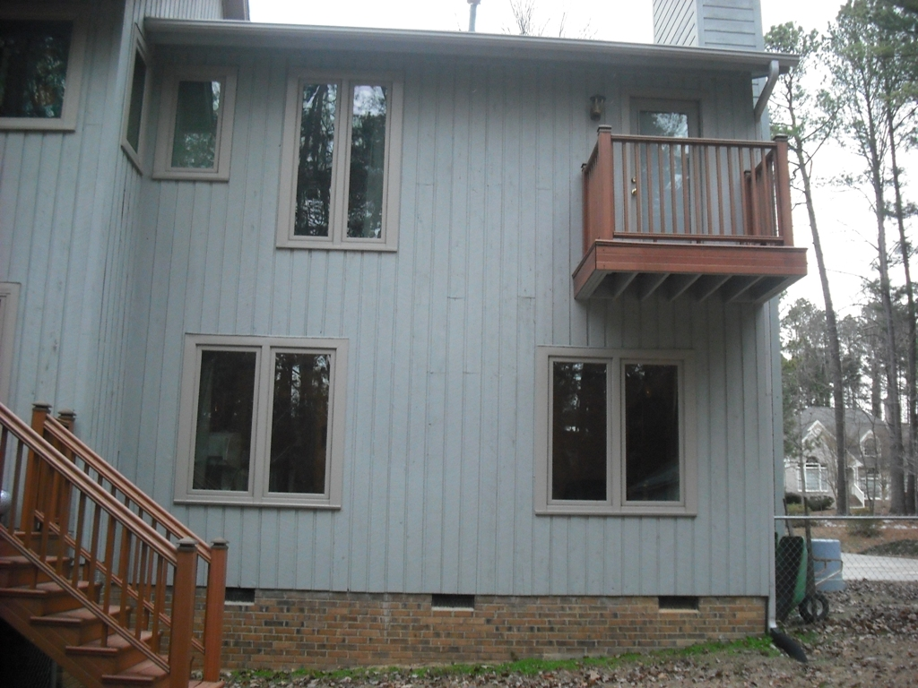
Before

Slide 3
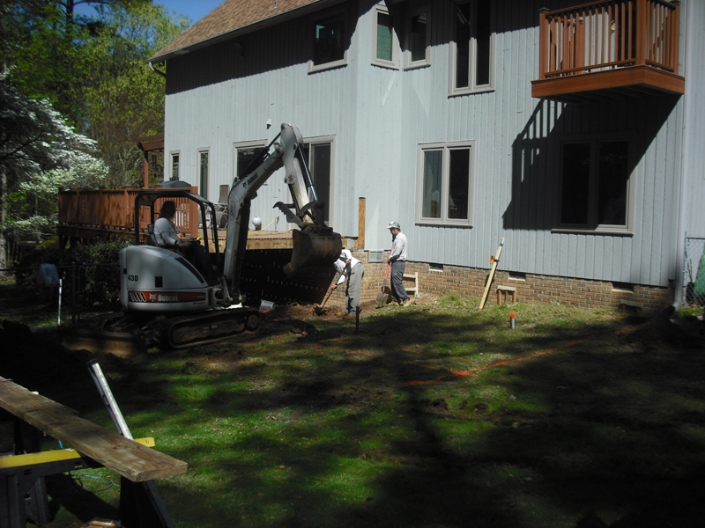
Before

Slide 4
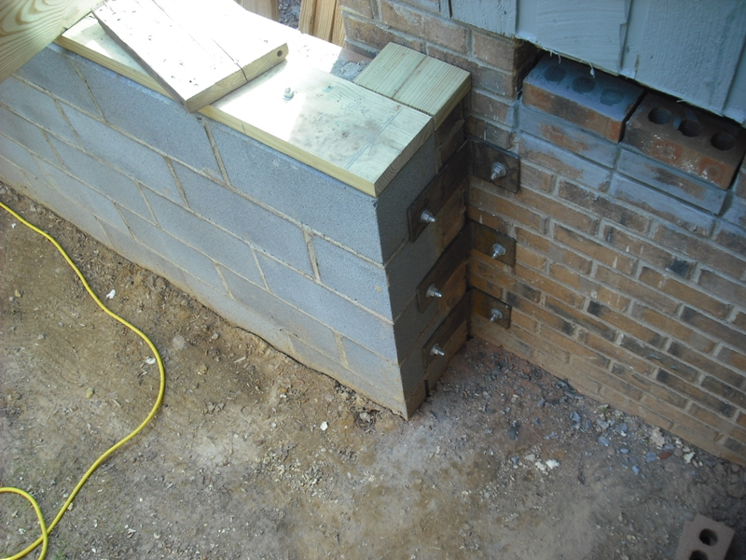
Foundation

Slide 5
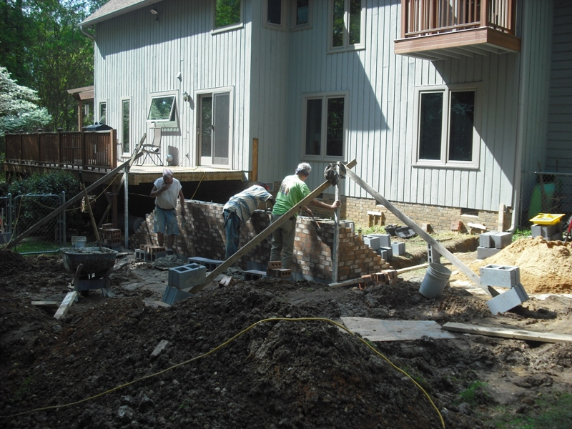
Foundation

Slide 6
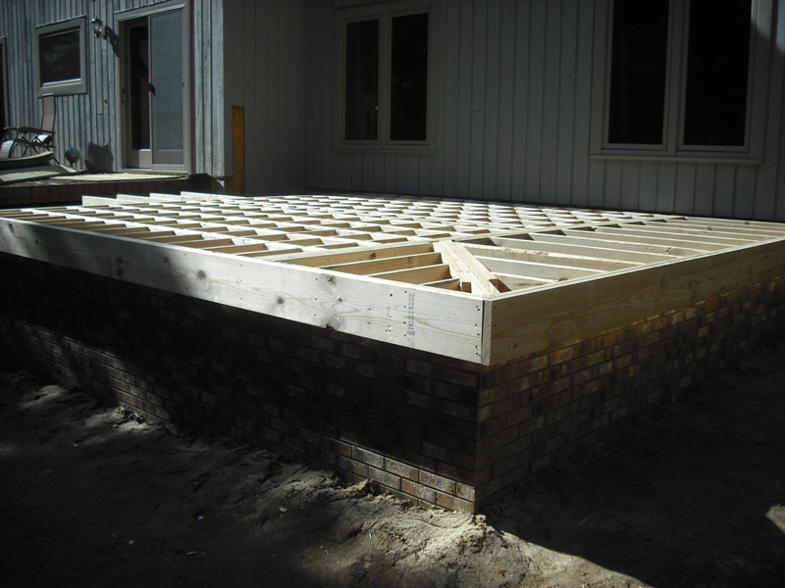
Floor Framing

Slide 7
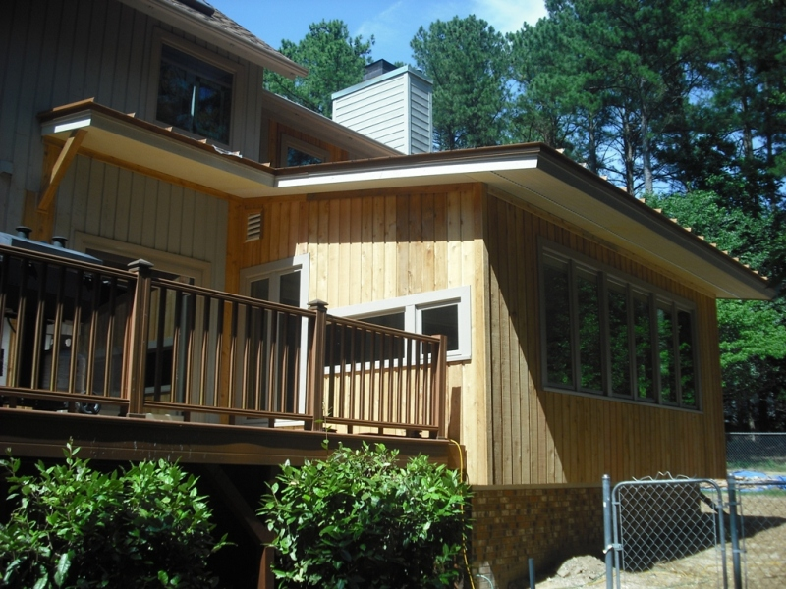
Siding

Slide 8
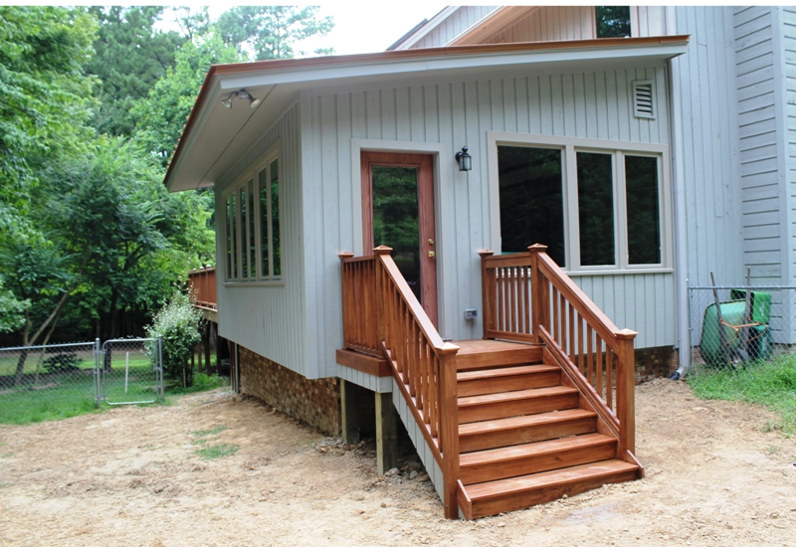
Exterior

Slide 9
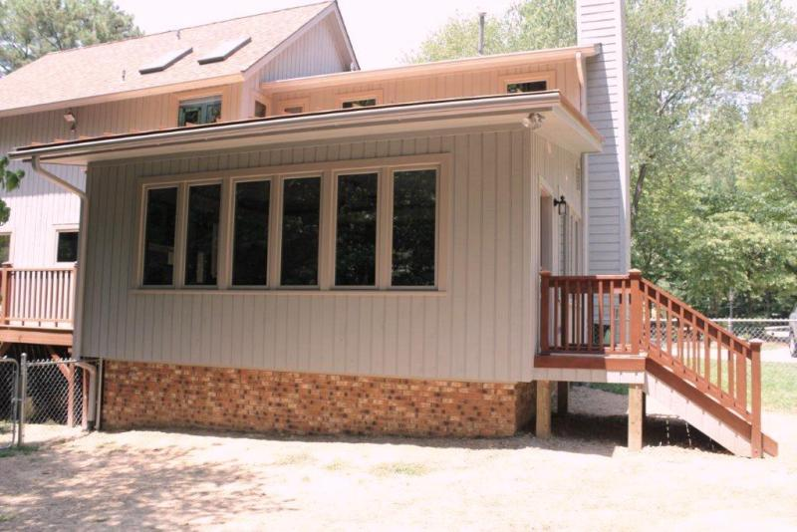
Exterior

Slide 10
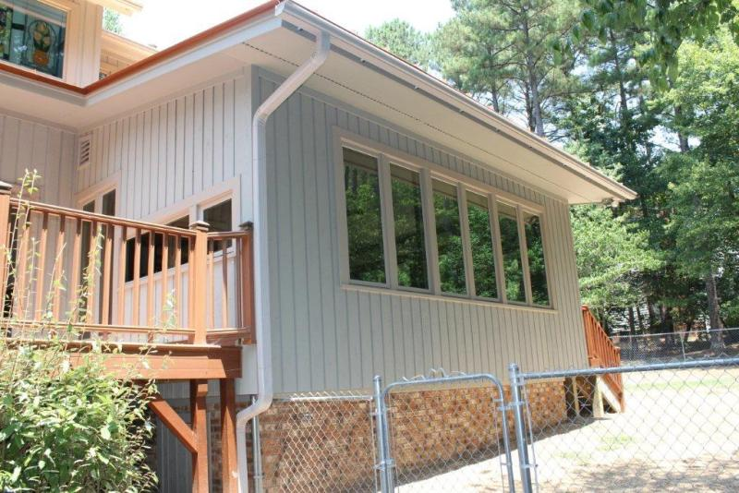
Exterior

Slide 11
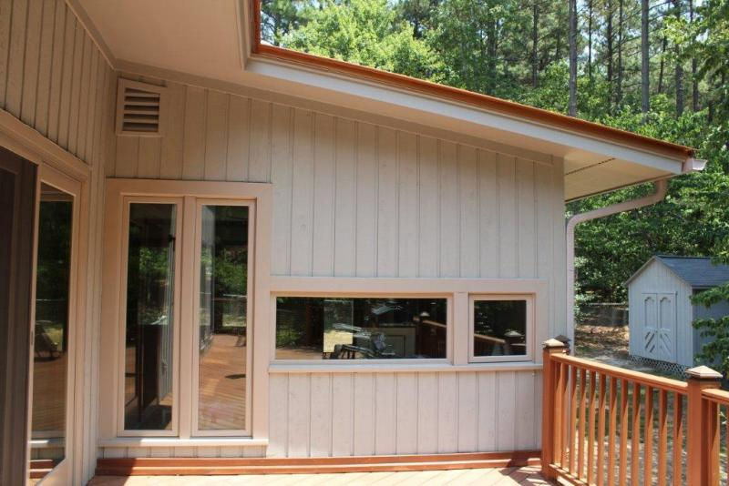
Exterior

Slide 12
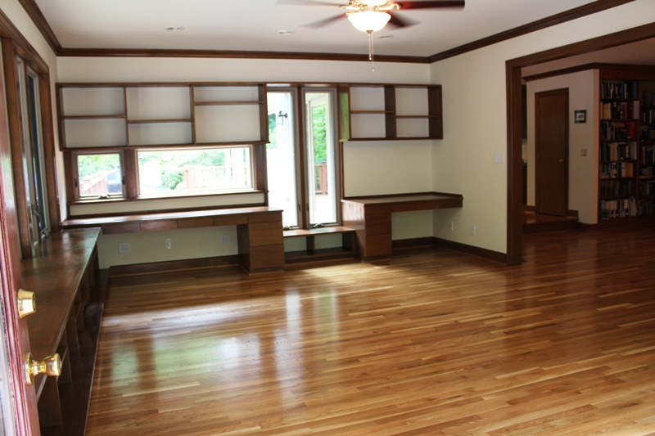
Interior

Slide 13
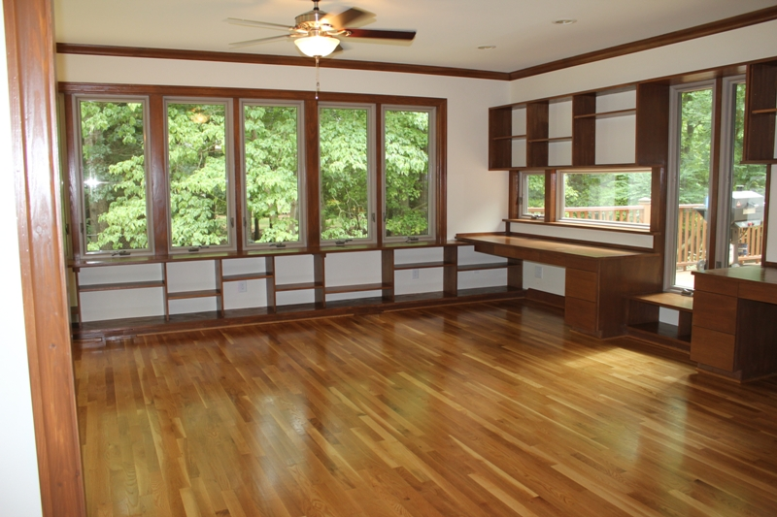
Interior

Slide 14
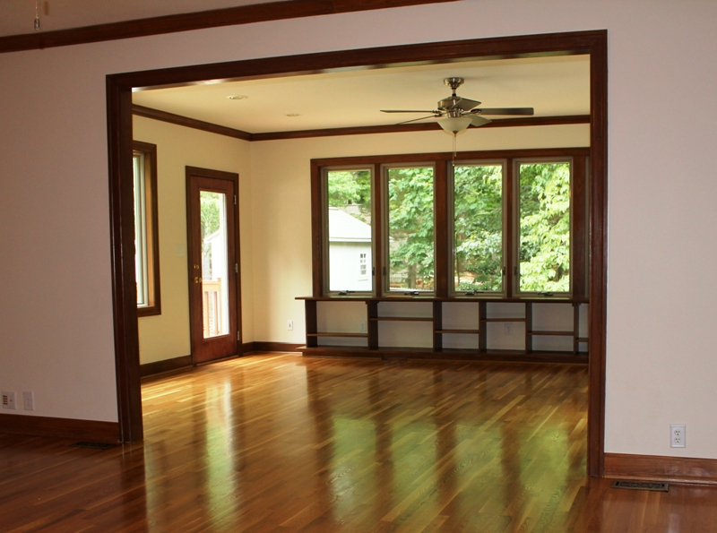
Interior

Slide 15
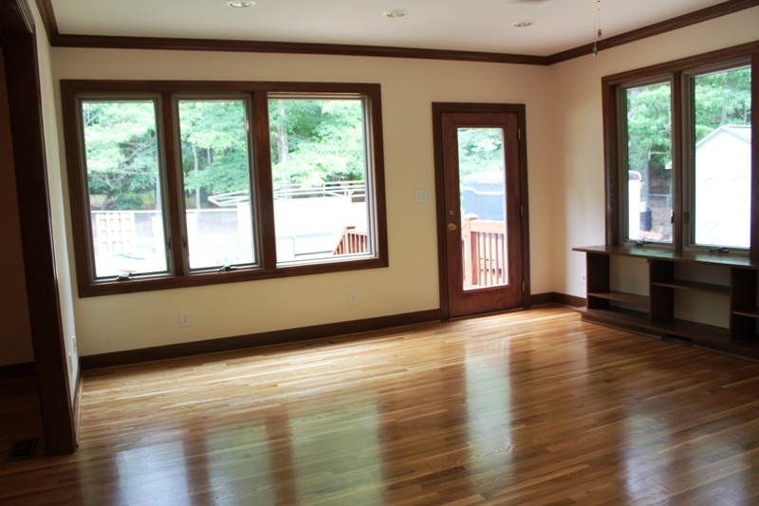
Interior

